Slide 1





Innovation and Entrepreneurship at ETH
Prepared for …..
Michael Stucky
Established
in 1855
20’000 Students
4’000 PhD Students
550+ Professors
16 Faculties
10‘000 Employees
21 Nobel
Laureates
6. Worldwide
1. Continental Europe
(QS Ranking, 2020)

Slide 2
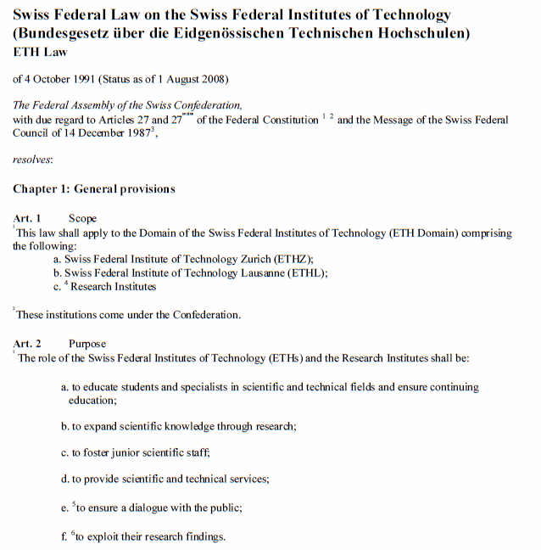
Missions of the ETH
Swiss ETH Law 1991
a) education
b) research
550 ETH Professors
16 Departments
f) Exploit research findings
ETH transfer

Slide 3
ETH transfer
Research contracts with industry and other third parties
Intellectual property and licenses
Entrepreneurship
Drafting, reviewing and negotiating research collaboration and service agreements, MTAs, NDAs
Legal advice concerning contractual relationships in the area of research
Approval of contracts with payments or material resources with a total value of CHF 50,000 or more via the office of the Vice President.
Management of intellectual property of ETH Zurich
Technology marketing
Negotiation of licensing contracts
Start-up support
Innovation and Entrepreneurship Lab
Pioneer Fellowship Program
Equity Management
Research contract guidelines
RSETHZ 440.31
Exploitation guidelines
RSETHZ 440.4
Spin-off guidelines
RSETHZ 440.5

Slide 4
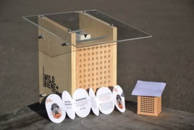


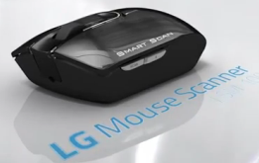
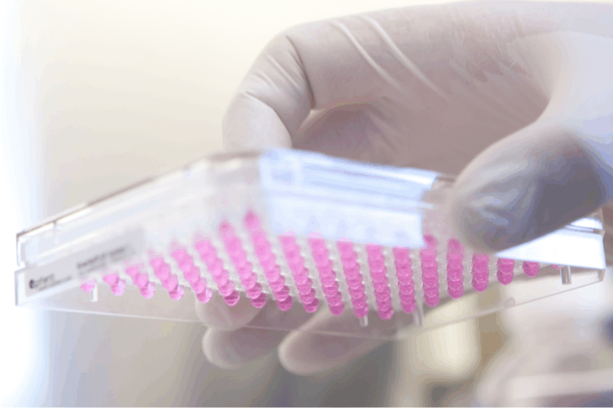
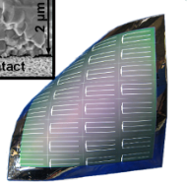


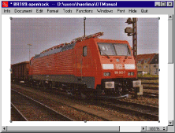





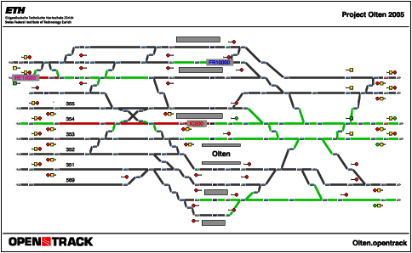
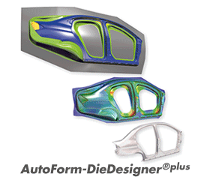

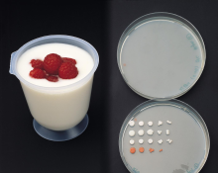

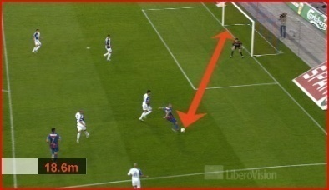
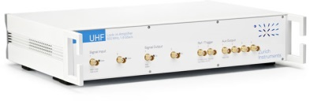




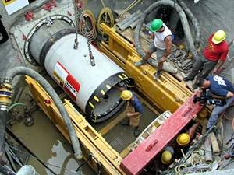
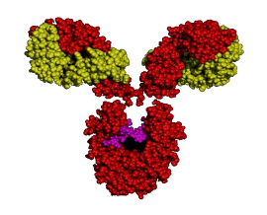
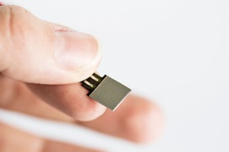

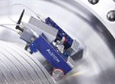
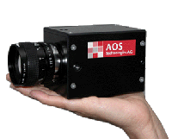

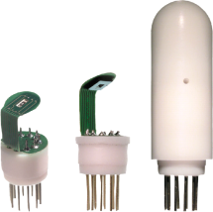
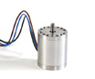


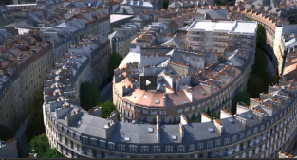
Technology Transfer to Society - ETH Technology Inside!
ETH transfer 2020
215 research contracts with industry
(> 50’000 CHF support)
180 invention-/ and software disclosures
111 patents
33 (42) license agreements
2’000 Masters + 1’000 PhDs
34 Spin-offs + many more Start-ups!

Slide 5
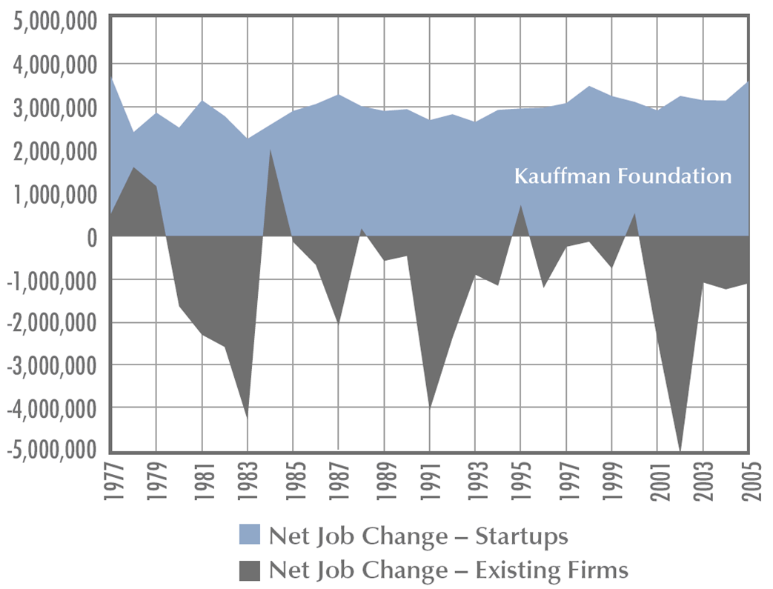
Start-ups Create New Jobs (USA Data)
Jobs created
Start-ups
Incumbent
Companies
Data: Kauffman Foundation, USA
Big companies start small !
Notes:
Start-ups
1. Due to the early character of the basic research findings, it has proven to be difficult for them to be adopted by the incumbent industry
2. Graph: impact start-ups make to society
3. Any large company started small, with an idea
The largest and well known Corporations in Switzerland, such as Novartis, Nestlé, ABB, Roche, Sulzer and IWC were founded by international Entrepreneurs!

Slide 6
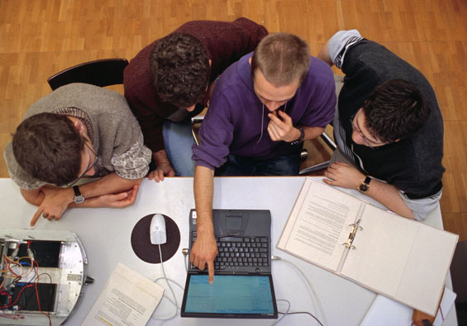

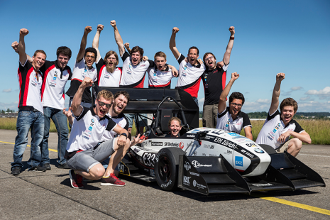
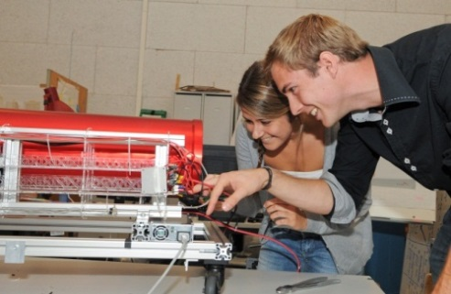
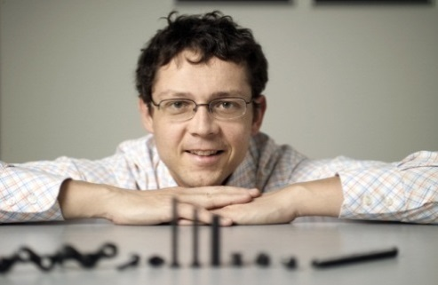
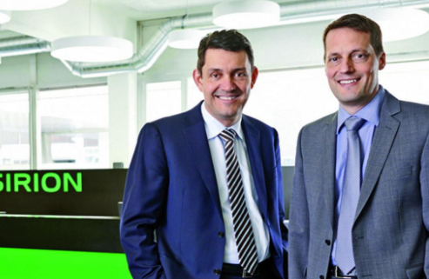

The Innovation & Entrepreneurship Culture of ETH
1st + 2nd
Mission
University
Industry
Focus Projects
Entrepren. Club
Master Thesis
PhD, Post-Doc
Pioneer
Fellowship
Spin-Offs
Entrepreneurs
Company
Exec. Officers
3rd
Mission
https://www.youtube.com/watch?v=M9-gCGJVPvY
Departments
Student Org.
Innovation &
Entrepreneurship
Lab
Incubators
Technopark
Corporate
World
Notes:
Path 1 at ETH: The classical way
Path 2 at ETH: Students take part in a Focus Projects
Examples of projects are “Scewo” a wheelchair that can go up stairs or AMZ (Akademischer Motorsportverein Zürich) “Formula Student” Project electrical car “grimsel” that broke a new world record by accelerating from 0-100kmh in 1.5 sec (Jun 2016). Sponsored student project (2014), 20’000 working hours, in collaboration with the HSLU.
Focus Project > ieLab > ieLab > Technopark / incubator
Technopark > Corporate world
Pic: Felix Mayer (l) Moritz Lechner (r) and Co-CEOs of Sensirion (spin off ETHZ ‘98)

Slide 7

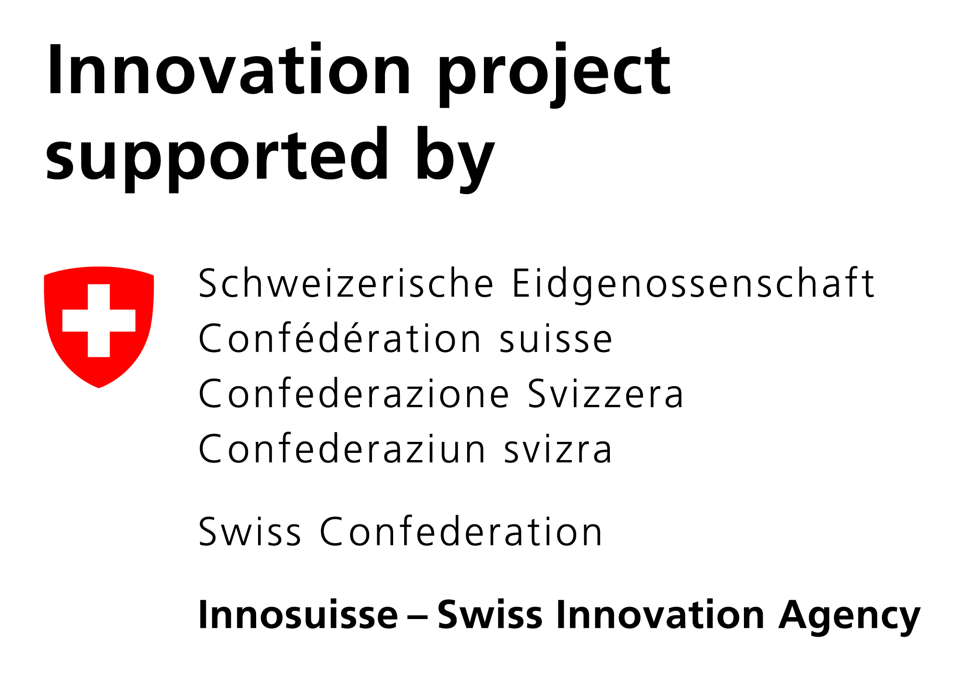
























Entrepreneurial Ecosystem of ETH Zürich
education
research
Bachelor >>
Master >>
Doctorate >>
Industry >>
  knowledge transfer
20’000 students
Pioneer Fellowship
Focus Projects
entrepreneurial
Chair of Entrepreneurship
entrepreneurial thinking
entrepreneurial acting
© ETH transfer
Notes:
SPH
Goals
Interdisciplinary
Self-initiative
Creativity
Workshops (DT)
Pre-Startup
Hackathlon
Infrastructure
Think & Work Space
Show & Connect Space
(Pitching / Presenting)
Maker Space
(Hands-on Experience)
FOCUS PROJECTS
From Idea to Prototype
Last year of Bachelor
20 ECTS
Basic Knowledge to Innovation
Interdisciplinary Teams
Out of comfort zone
ETH Juniors
Student Organisation
Outplacement of Students
Industry Partners
> 1 Mio
ETH ENTREPREUENR CLUB
Entrepreneurship Promotion
Student Organization
Non-Profit, Sponsors
Co-working Space by ETH
Co-located with ieLab
15 start-ups
Events
From Science to Startup
Startup Speed Dating
F*ckUp Night
ETH EC Award
InCube Challenge
PIONEER FELLOWSHIP
From Research to Market
Competitive, Jury by VPFW
18 month
150 KCHF
Coaching by the ieLab
Donations by Program Partners via ETH foundation
Success
84 PF since 2010 (12 Mio CHF)
Projects ~ 20
Spin-offs founded 50 (66%)
INNOVATION & ENTREPREUENRSHIP LAB
“Deep Science Incubator”
Services
Individual Coaching by Serial Entrepreneurs
Stage Gate Process
Trainings
Events
Networking
Infrastructure - 2 locations
Co-Working Spaces (48)
BioSafety Lab (42)
Prototype Room
Network Room
Brainstorm Room
Seminar / Meeting Rooms
Event Room
WYSS ZURICH
“Robotics & Translational Medicine”
Translating Science to Life
USD 120 million donation by Hansjörg Wyss in 2014
ETHZ and UZH
Incubation
Robotics
Regenerative Medicine
ESA Business Incubation Center CH
Space related technologies
Managed by ETH (est. 2016)
10 start-ups p.a. in CH
Incentive Phase 50 k€
Booster Phase: > 450 k€
Business & technical support
ETH Alumni - fit for
Academia & Industry
Critical Thinking
Problem Solving
Lean, Agile, Design Thinking
Interdisciplinary
Creative
Team player
Entrepreneurial, Biz Model
ETH spin-off Success Stories
400 spin-offs (since 1996)
ca. 25 spin-offs p.a.
5 years survival 92%
> 2b CHF since 2002
IPO and acquisitions

Slide 8
Founders «Valley of Death»
Public Funds
Public / Private Gap !
Investors
Research Grants
(NSF, EU Grants)
Development Grants (CTI …)
Pre-Seed Grants
Friends, Family & Fools
Business Angels, Seed VCs
Early Stage VCs, Corp. Partners
Late Stage VCs
Private Equity
M&A / IPO ..
Incorporation
Basic Research
Applied Research
Proof of Concept Business Case
Valley of Death
Prototype
Growth / Revenue
Product
Development
Alpha Series
ETH spin-offs
Focus Projects
Student Projects
Technopark Zurich
Wyss Zurich
ESA BIC Switzerland
Pioneer Fellowships
Innovation & Entrepreneurship Lab
Entrepreneur Club
Student Project House
16 ETH Departments

Slide 9

Ask successful entrepreneurs
‘’What would have made a major difference in the early phase of your young start-up?’’
Notes:
Goals for ETH spin off: to create better, larger more valuable and more sustainable businesses …
How did we find out how to achieve these goals? We asked already successful ETH entrepreneurs the following question: “What …….”
Q: Any idea what their answers were?

Slide 10
What are founders‘ needs?
Funding Initial non-dilutive funding (sweet money) to bridge the “valley of death” to move ideas from scientific findings to a early stage start-up
Home A peer home (’’a biotope’’) for like-minded young ETH scientists with entrepreneurial aspirations: Peer support and peer pressure
Coaching Supervision and support by experienced, successful entrepreneurs with a similar background: Compelling role models
Connect Access to all ETH entities, > 460 ETH spin-offs, Investors, CH Start-up ecosystem, coaches, experts, service providers …
Education Certificate of Advanced Studies in Entrepreneurial Leadership in Technology Ventures (CAS ELTV)
Notes:
So these are the answer we received:
Seed Capital – early stage capital when to advance the technology when no investor would dare (risk) to invest to bridge the gap from scientific results to early stage start-up
Second, they wanted a peer home, a biotope for …. They wanted peer support but also peer pressure. In an open work environment they would be part of other pioneer fellows attempting to get their company off the ground.
If they see other pioneer fellows struggle, they would know they are not alone and they would not give up. If they would see their peer pioneer fellows to be successful they would be more motivated to be also successfully.
Third, they wished supervision by experience and successful entrepreneurs with a similar background. They wished for compelling role models.
Forth: Network: Third, they wished low-threshold access to all ETH network and the Swiss Start-up Scene, in particular ETH-Transfer, and to the complete ETH network. Contact to 300+ entrepreneurs. What do you think would happen if a student contact a CEO of an successful company or call up a professor at ETH. Probably not much. However if I or xxx contacts a CEO we do not get rejected and we can establish the contact. Our ETH ieLab team which consist of successful entrepreneurs who have also had assignments and vast experience internationally, mostly the USA, and external coaches enable us to provide the contact with almost anyone in the world who could be relevant to our ETH spin-offs and Pioneer Fellows
Beekeeper Online platform
So, what is the concrete offering of ETH to young entrepreneurs?

Slide 11

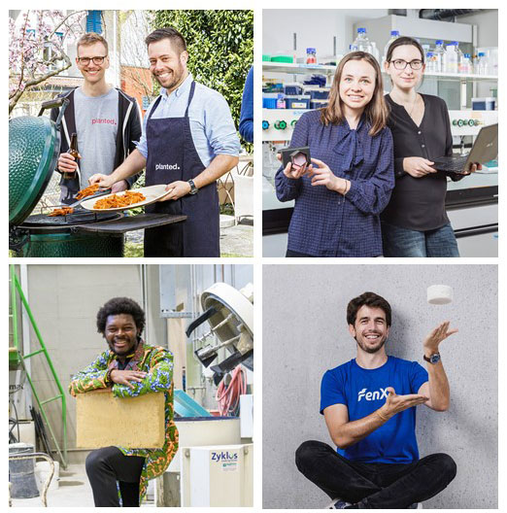




Pioneer Fellowship Program (est. 2010)
Donations from Industry Partners, Private Persons and ETH Zurich
18 month program, 150 kCHF sweet (non-dilutive) funding, financed by donations (via ETH foundation)
Promote ETH talents who want to pursue an entrepreneurial career
Commercialization of ETH technology
Support at the Innovation & Entrepreneurship Lab (ieLab)
Host Professor & Research group, access to ETH infrastructure
Application Process
ETH M.Sc. / PhD. graduates
Application twice per year; 1 March & 1 September
Selective jury process, 40% acceptance rate, 10-15 PF p.a.
Notes:
Goals for ETH spin off: to create better, larger more valuable and more sustainable businesses …
How did we find out how to achieve these goals? We asked already successful ETH entrepreneurs the following question: “What …….”
Q: Any idea what their answers were?

Slide 12

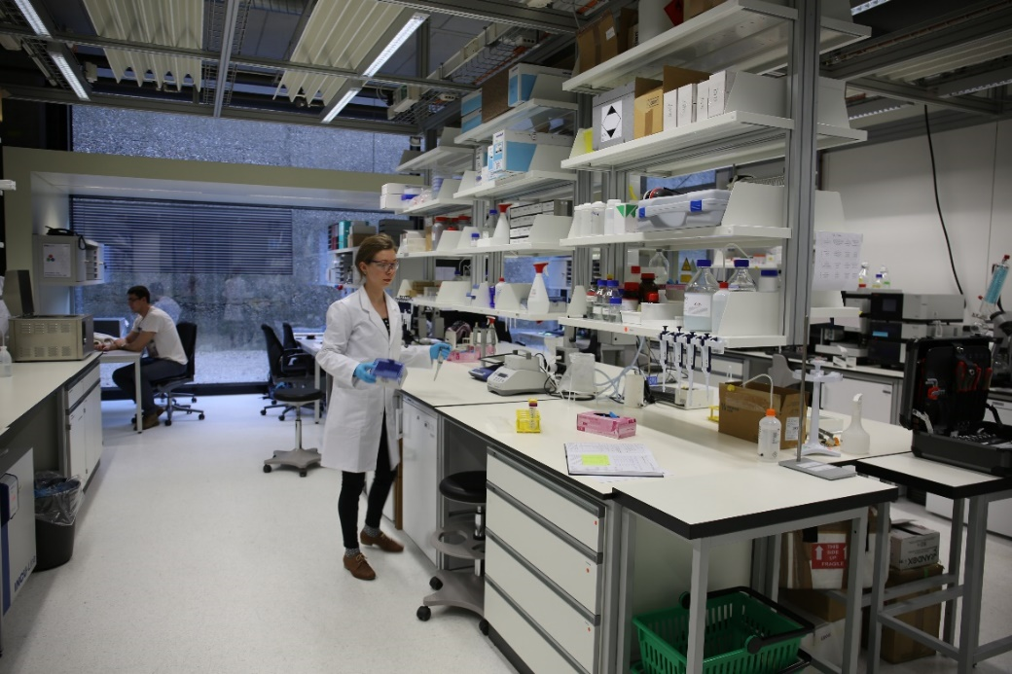
Innovation & Entrepreneurship Lab - ETH Technology Incubator
Space 48 working desks 300 sqm ¦ 42 Bio Safety Lab benches 200 sqm
Coaching Coaching by experienced serial entrepreneurs & industry experts
Education CAS in Entrepreneurial Leadership in Technology Ventures (CAS ELTV) & Seminars
Networking Events & Seminars
Connect ETH entities, more than 550 ETH spin-offs, investors and the CH start-up ecosystem
ICT, Engineering, Robotics
Bio Safety Lab
ETH Zentrum, STE Building Stampfenbachstrasse 52, 8092 Zurich
ETH Hönggerberg, HPL Building Otto-Stern-Weg 7, 8093 Zürich
Notes:
So these are the answer we received:
Seed Capital – early stage capital when to advance the technology when no investor would dare (risk) to invest to bridge the gap from scientific results to early stage start-up
Second, they wanted a peer home, a biotope for …. They wanted peer support but also peer pressure. In an open work environment they would be part of other pioneer fellows attempting to get their company off the ground.
If they see other pioneer fellows struggle, they would know they are not alone and they would not give up. If they would see their peer pioneer fellows to be successful they would be more motivated to be also successfully.
Third, they wished supervision by experience and successful entrepreneurs with a similar background. They wished for compelling role models.
Forth: Network: Third, they wished low-threshold access to all ETH network and the Swiss Start-up Scene, in particular ETH-Transfer, and to the complete ETH network. Contact to 300+ entrepreneurs. What do you think would happen if a student contact a CEO of an successful company or call up a professor at ETH. Probably not much. However if I or xxx contacts a CEO we do not get rejected and we can establish the contact. Our ETH ieLab team which consist of successful entrepreneurs who have also had assignments and vast experience internationally, mostly the USA, and external coaches enable us to provide the contact with almost anyone in the world who could be relevant to our ETH spin-offs and Pioneer Fellows
Beekeeper Online platform
So, what is the concrete offering of ETH to young entrepreneurs?

Slide 13






























































62 Spin-offs by Pioneer Fellows 2010 - 2020
Hallcube
2018
2011/12
2013
2014
2015
2016
2017
2019
2020

Slide 14

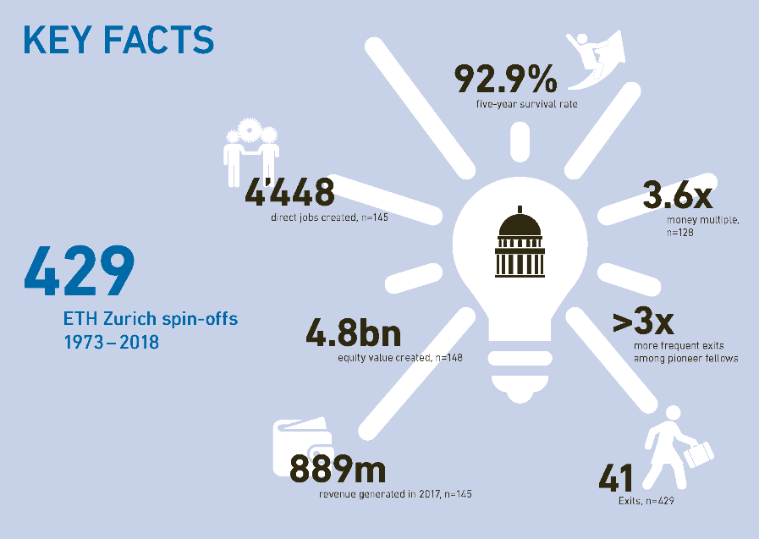
2020 performance study highlights the contributions of the ETH spin-offs to the Swiss economy
As of 2018, 429 ETH Spin-offs created close to 4’448 jobs (n=145)
A total of CHF 889m revenues generated in 2017 (n=145)
4.8bn equity value created (n=148)
The spin-offs showed a 92.9%
5-year survival rate
Notes:
Data in the new study cover the spin-offs until the end of 2018

Slide 15
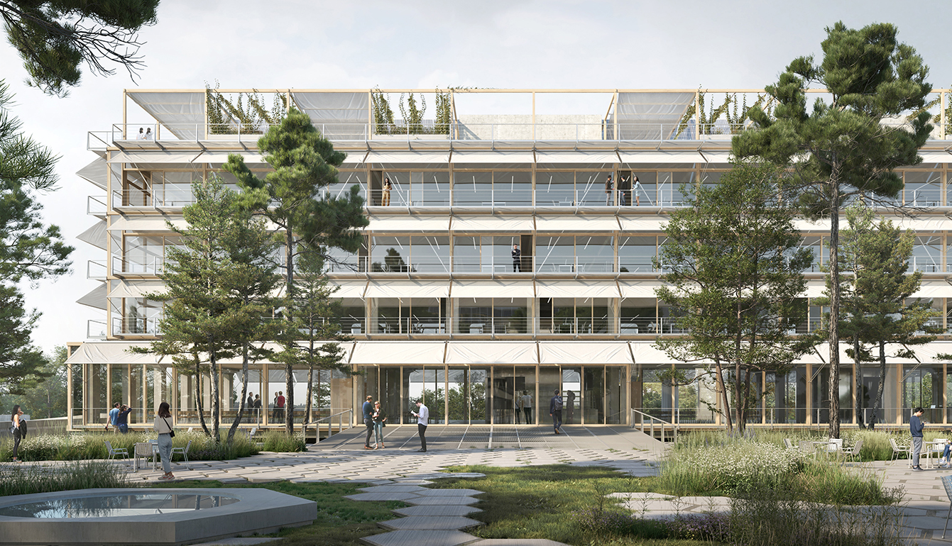
Bringing entrepreneurship under one single roof
> 9‘000 square meters (sqm)
> 1‘000 sqm for entrepreneurship
> 500sqm maker space, >200sqm wet labs
ETH Centre for Students and Entrepreneurs

Slide 16
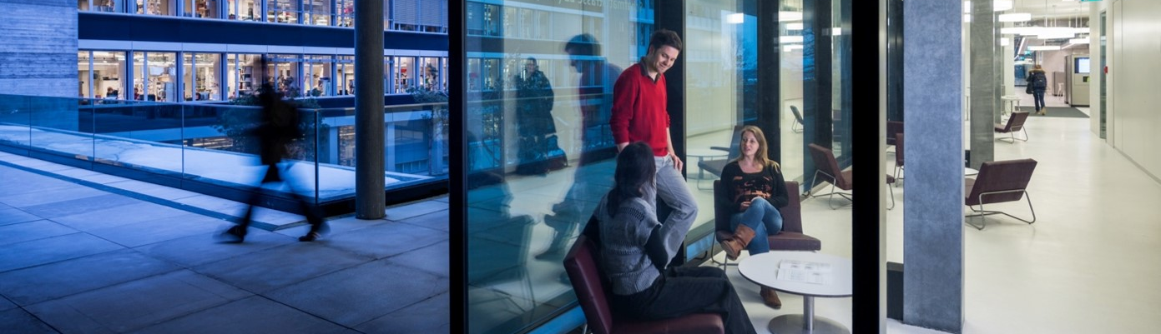




Thank you for your attention
Michael Stucky
ETH Innovation & Entrepreneurship Lab
+41 79 411 5247 I michael.stucky@sl.ethz.ch
www.ethz.ch/ielab I www.transfer.ethz.ch I www.spinoff.ethz.ch I www.ethz.ch/entrepreneurship

